Slide 1
Swiggy Analysis Report
Business Intelligence Task -2
Kiran S

Slide 2
Contents
Key Findings for Swiggy
Key Findings for Restaurants
Overall Recommendations

Slide 3
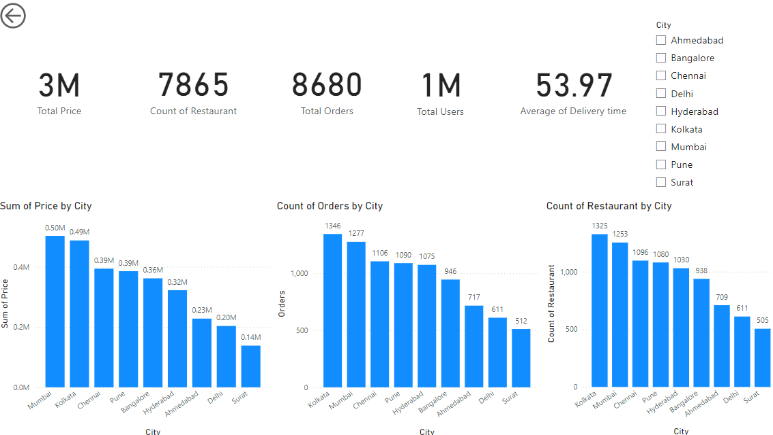

Slide 4
Key Findings for Swiggy
Total orders placed through swiggy on single day is 8680.
Total people on swiggy according to total ratings is around 1 million.
Total price orders through swiggy on single day is around 3 millions.
Total Restaurants under swiggy access is 7865.
Most number of orders were placed from Kolkata, Mumbai followed by Chennai, Pune, Hyderabad.
Highest total sum orders were from Mumbai, Kolkata followed by Chennai, Pune, Bangalore.
In spite of less number of orders comparatively Bangalore has good amount of money spent through swiggy.

Slide 5
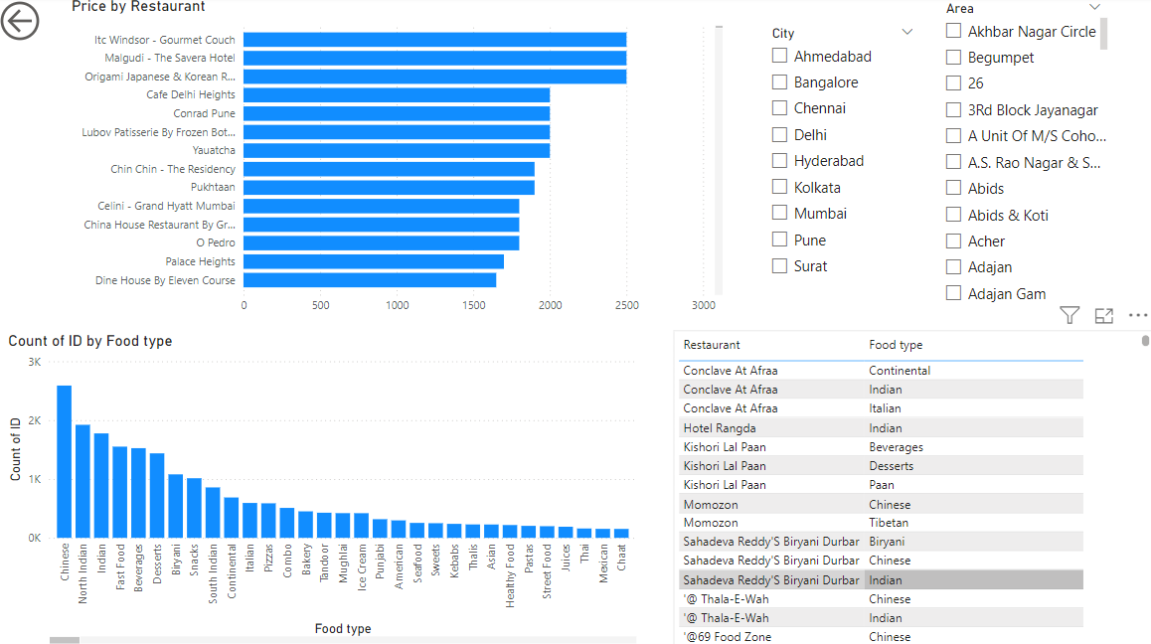

Slide 6
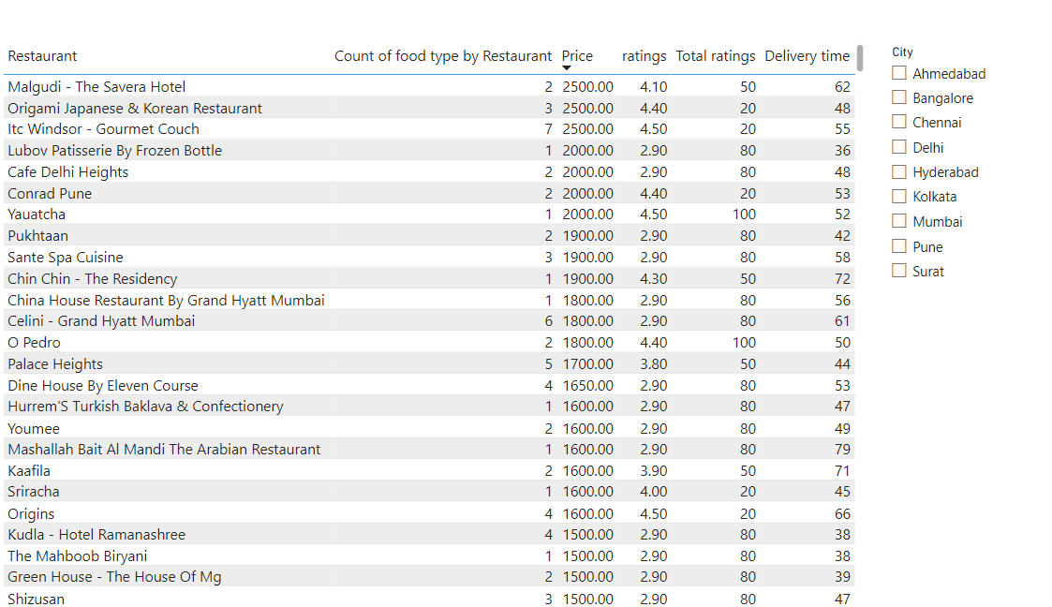

Slide 7
Key Findings for Restaurants
Chinese and North Indian foods are most preferred choice for food type on overall orders but changes with city.
Restaurants with minimum delivery time gets good ratings with most number of customers.
As Varieties increase in menu of a restaurant keeping price affordable, increases its ratings and orders.
But keeping few varieties but delivering them at least time brings highest number of customers.

Slide 8
Overall Recommendations
As per growth of business we should focus on cities like Mumbai, Kolkata, Chennai, Pune, Bangalore, Hyderabad on providing delivery at minimum time possible.
For other cities like Ahmedabad, Surat, Delhi our first goal should be linking more restaurants with swiggy for orders placing.
As most of the people likes Chinese and North Indian foods we should connect to those restaurants that provide majorly of these food types.

